Slide 1

LDRP Institute of Technology and Research Major Project – 8th Semester
Internal Guide:
Dr. Bela Shrimali
Head of Department:
Dr. Shivangi Surati

Slide 2
ELMS (Employee Leave Management System)
Presented by: Sahil Darji
Smit Gautami
Vivek Jethva
Dhaval Gusai

Slide 3
Outline of Presentation
What is ELMS(Employee leave management system)?
Introduction
Motive
ELMS(Employee leave management system) methodology
System user
Admin and Employee feature
Features
Functional Requirements
System Designs
Objectives
Functionalities
Screen Designs
Future Scope
References

Slide 4
What is ELMS(Employee leave management system)?
Handles all employee leave requests.
ELMS making it hassle-free for both the management and the employees.
Decrease the paper work.
Leave approach – record leaves & reduce time.

Slide 5
Introduction
Use to store data of employee
We can see the leaves
Smooth and effective manner
Show error message
Leads to error free, secure, reliable and fast management system
Remote access features

Slide 6
Motive :
Create an online leave management system
Reduce paper work and time
Manage all the records
Help to keep the data of EL
Find easily leaves
Stored for a longer period

Slide 7
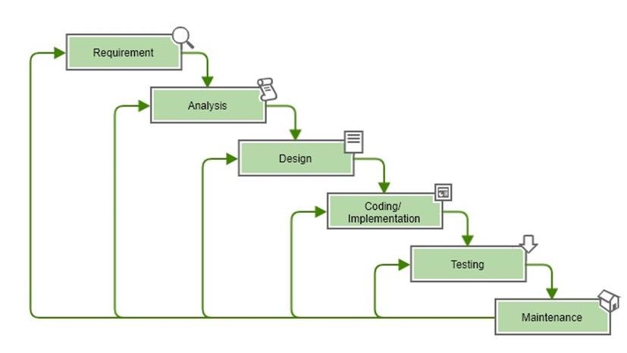
ELMS(Employee leave management system) methodology
Waterfall Model
We have used Waterfall model in our ELMS(Employee leave management system)

Slide 8
System User :
Admin
Employee

Slide 9
Admin Features
Admin Login
Admin can also view admin dashboard
Admin can change password after login
Admin can add, update and delete leave type
Admin can add, update and delete departments
Admin can add an employee and also update the employee info
Admin can also manage the leave application(approve and not approve)
Admin Logout

Slide 10
Employee Features
Employee login
Employee can Update Profile
Employee can apply for leave
Employee can View the leave Status
Forget Password Recovery
Update Password
Employee Logout

Slide 11
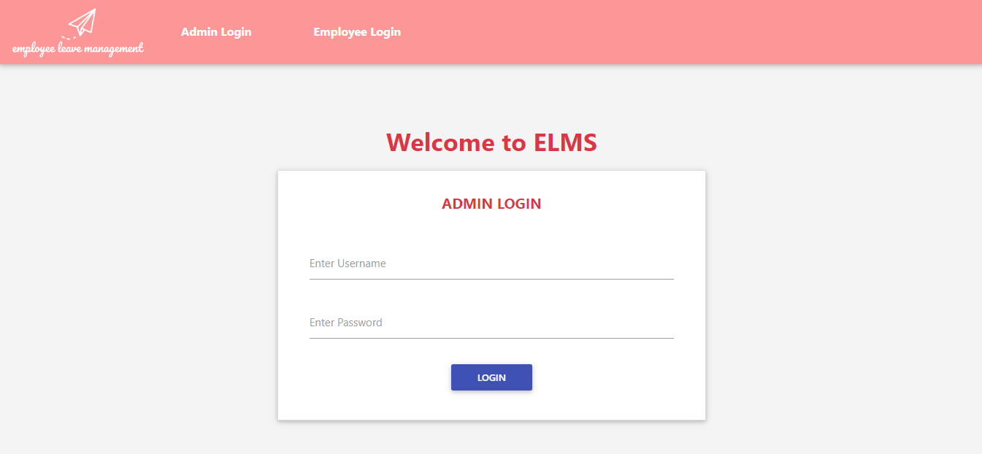
Screen Design(Admin)

Slide 12
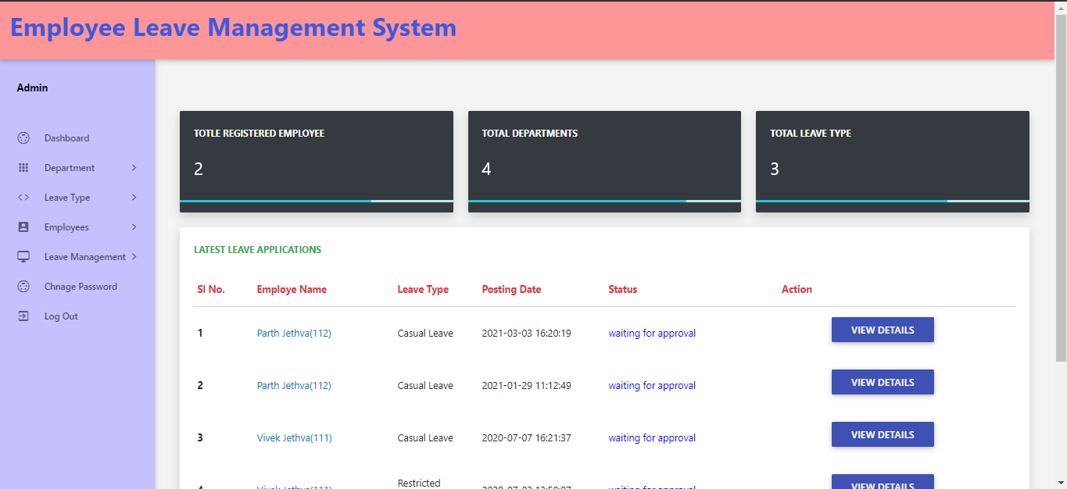

Slide 13
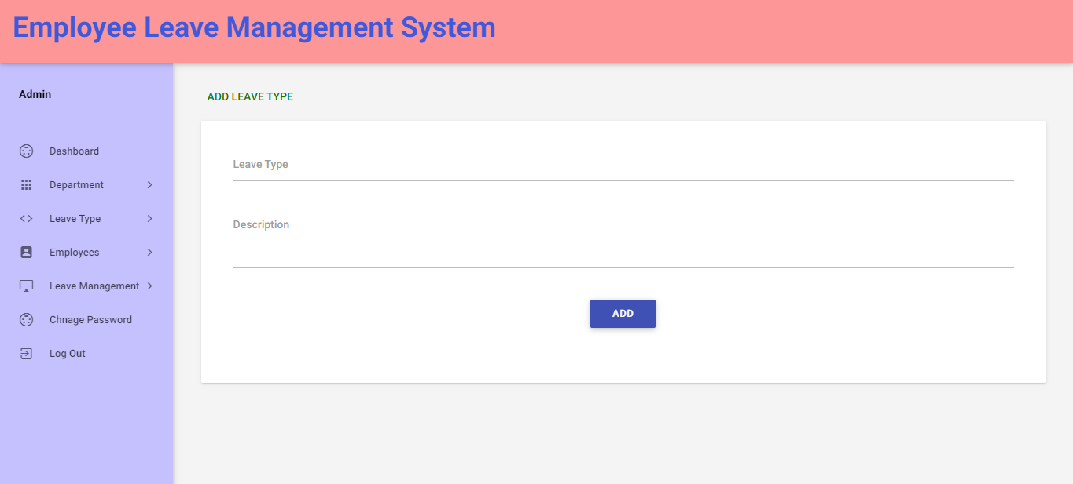

Slide 14
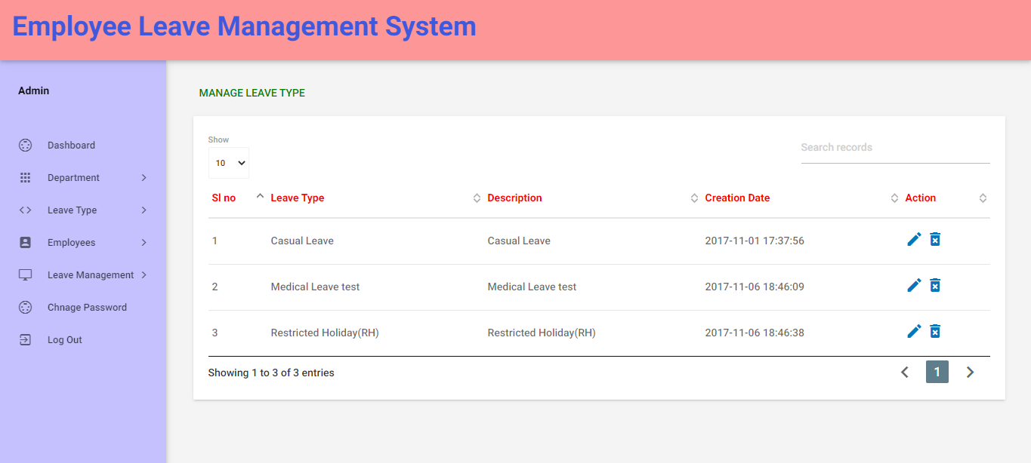

Slide 15
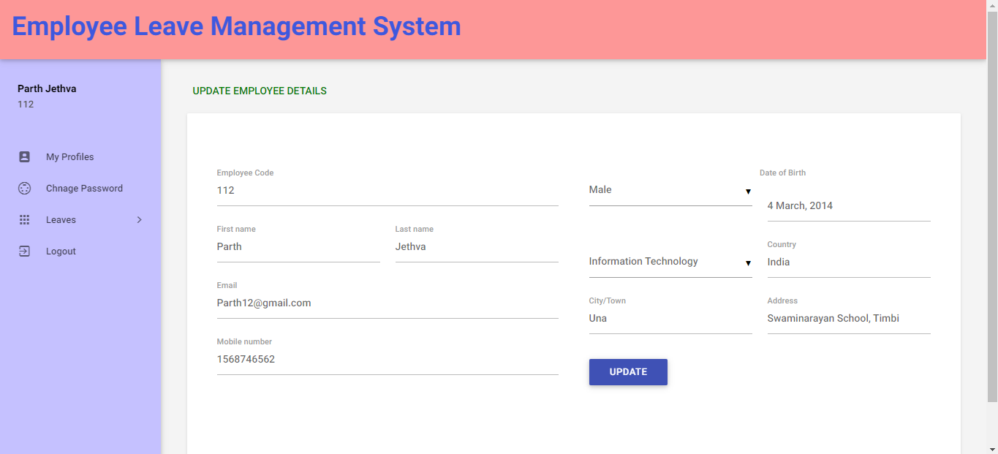
Screen Design(Employee)

Slide 16
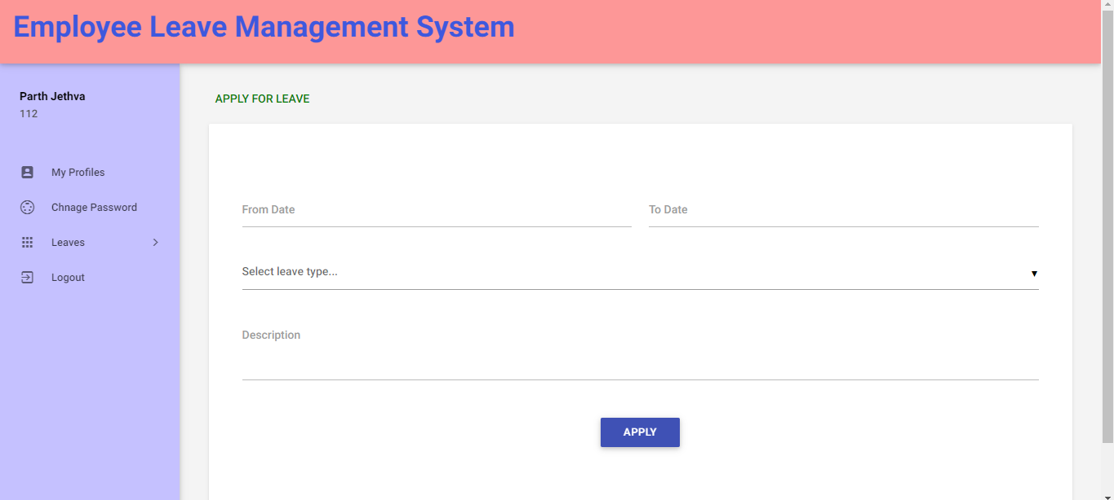

Slide 17
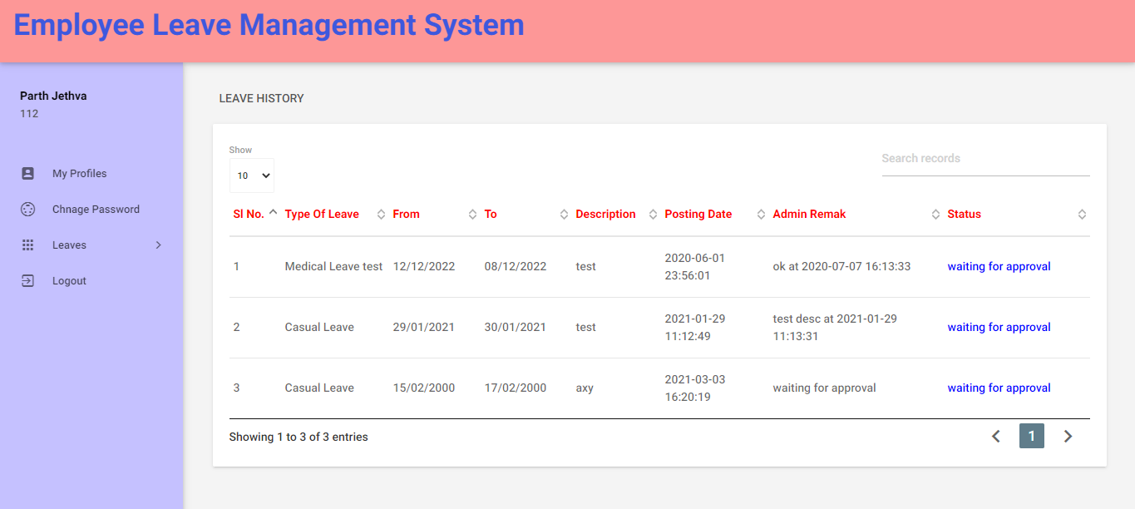

Slide 18
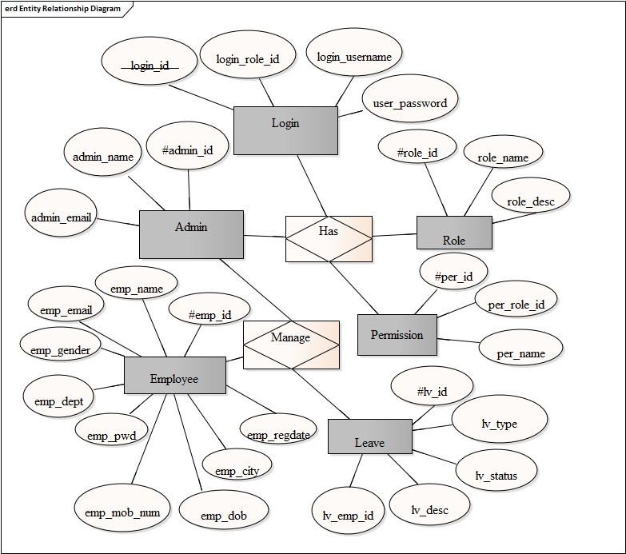
System Designs
ER Diagram

Slide 19
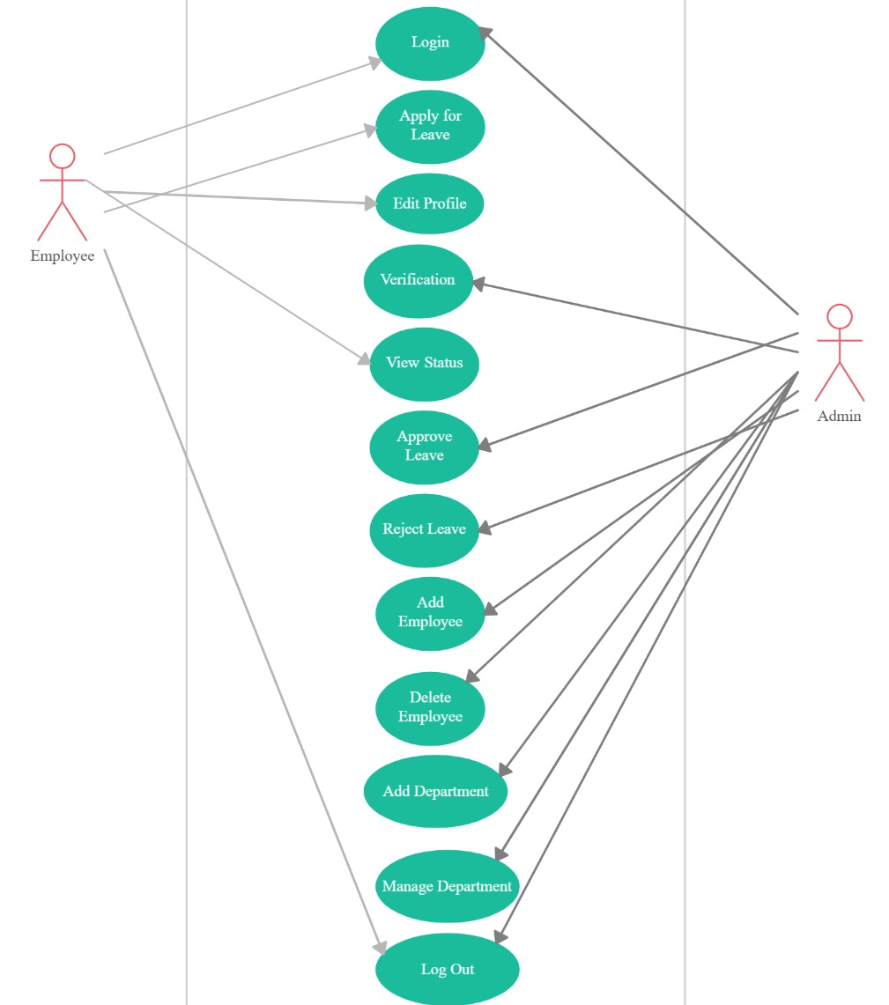
Use-Case Diagram

Slide 20
Features
Remote access
Security of data
Ensure data accuracy’s
Proper control of the higher officials
Minimize manual data entry
Minimum time needed for the various processing
Greater efficiency
Rapid and better service
User friendliness and interactive
Minimum time required

Slide 21
Functional Requirements
Hardware
Software
Processor: Pentium III
RAM: 128 mb
Hard Disk: 20 GB
Language: PHP
Front End(User Interface): HTML 5,AJAX,JQUERY,JAVASCRIPT,BOOTSTRAP
Back End: MYSQL
Server: Xampp

Slide 22
Objectives
ELM System is to manage the details of Employee, Leave and Leave type
The project is totally built at administrative end and thus only the administrator is guaranteed the access
The purpose of ELMS is reduce the manual work for managing the Employee, Leave, Leave Type and Company

Slide 23
Functionalities
Provides the searching facilities based on various factors. Such as Employee, Company, Admin, Types of leave
It tracks all the information of Leave, Leave Type
Manage the information of Leave
To increase efficiency of managing the Employee Leave
Admin dashboard available to track all the details of leave of each and every employee
Search for type of leave applied for is available for feasibility

Slide 24
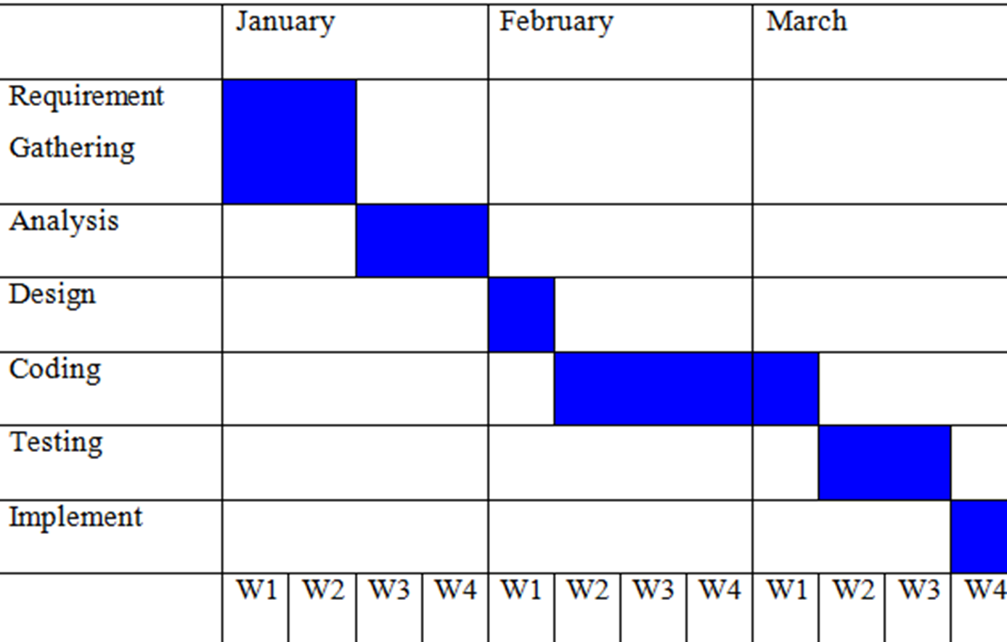
Gantt Chart

Slide 25
Future Scope
We can add print details feature
We can give more advance software for Employee Leave Management System including more facilities
We will host the platform on online servers to make it accessible worldwide
Integrate multiple load balancers to distribute the loads of the system
Manage Employees, Leaves , Department
Filtration of leave

Slide 26
References
https://www.wikipedia.org/
www.msdn.microsoft.com
www.developer.com
www.15seconds.com
THANK YOU!

